Slide 1
Fresh Grads – Group Project
Online Gas Booking application

Slide 2
Problem Statement
To Create an Application for Online Gas Booking
Customer should be able to view the no. of gas cylinders, it can book.
Customer should be able to book gas cylinder for desired address.
Admin should be able to perform below operations:
1. Gas Cylinder Management
2. Customer Management
3. Booking Management

Slide 3
Road Map
Application will be developed in following Sprints –
Core Java +JPA with Hibernate
Spring Boot + Rest Controller + JPA with Hibernate
Angular for UI design (Front End) + Integration with previous Sprint

Slide 4
Plan
Design
Generate the skeleton as per class design provided
TDD approach
Identify test cases for each module
Write Failing Test cases
Convert the Test Cases in GREEN
Implement the case study in incremental manner

Slide 5
Modules
Login Module
Admin
Module
Customer Module
Cylinder Management Module
Cylinder Booking
Management Module

Slide 6
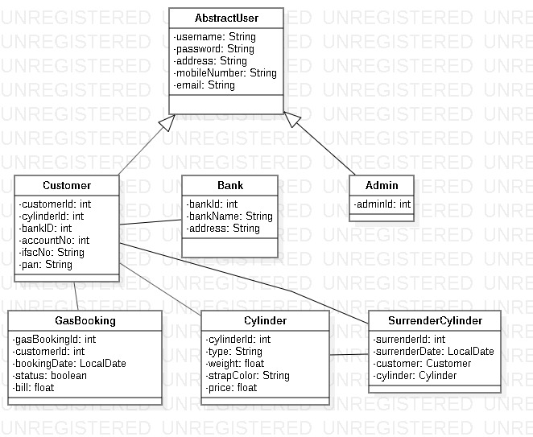
Class Design
POJO Classes:
1 1
1
1
1
M
1
1
1
1

Slide 7
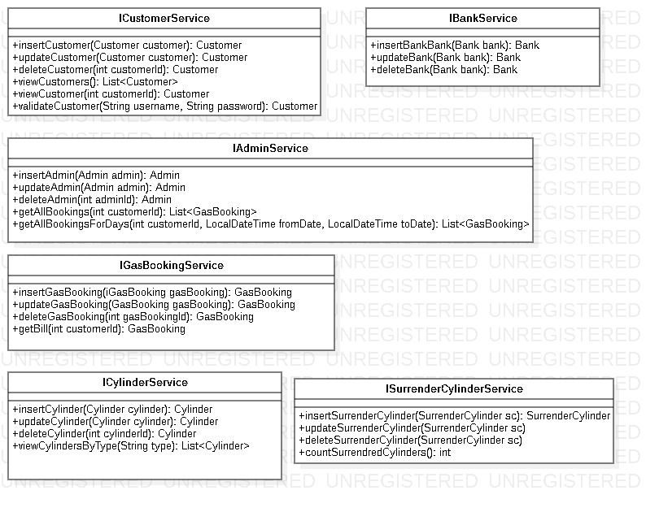
Class Design
Service Interface:

Slide 8

Class Design
Repository:

Slide 9




Questions

